Slide 1
Mahjong
Areana Powell

Slide 2
• Where did the game originate & possible date of origination?
is a game that originated in China. It is commonly played by four players (with some three-player variations found in South Korea and Japan)

Slide 3
• How do we know the game existed?
The game and its regional variants are widely played throughout Eastern and South Eastern Asia and have a small following in Western countries.

Slide 4
• What did the game pieces (board) look like?
The game is played with a set of 144 tiles based on Chinese characters and symbols, although some regional variations use a different number of tiles. In most variations, each player begins by receiving 13 tiles.

Slide 5
• How many players were required?
4 people

Slide 6
• Do actual rules of game play exist?
Yes

Slide 7
• How do you play the game?
Each player takes a turn picking up a tile from the wall and then discarding a tile by throwing it into the center and, if desired, announcing out loud what the piece is. Play continues this way until one player has a legal winning hand and calls out mahjong while revealing their hand. There are four different ways that this order of play can be interrupted.
During play, the number of tiles maintained by each player should always be thirteen tiles (meaning in each turn a tile must be picked up and another discarded). Not included in the count of thirteen tiles are flowers and seasons set to the side and the fourth added piece of a kong. If a player is seen to have more or less than thirteen tiles in their hand outside of their turn they are penalised.

Slide 8
• How long does it take to play a game?

Slide 9
• Are there other names for the same game?
the game was originally called 麻雀 (pinyin: máquè)—meaning sparrow—which is still the name most commonly used in some southern Chinese languages such as Cantonese and Min Nan

Slide 10
• Is the game related to other ancient games?
Because of the solid form of the tiles, mahjong is sometimes classified as a domino game but plays similar to card games such as rummy.

Slide 11
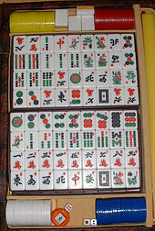
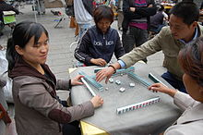
• Photos or drawings of game board, pieces, historical documents

